Slide 1
Asset Price Bubbles: Identification, Causes and Response

Slide 2
GROUP-1 MEMBERS
1.Pakshal Secretary (Eco)- 190581- pakshal@iitk.ac.in (Group Leader)
2.Siddharth Kumar Singh (Eco)- 190840- sksingh@iitk.ac.in
3.Tanishq Gupta (BSBE)- 190894- tanishqg@iitk.ac.in
4.Aman Dixit (BSBE)- 190103- amandx@iitk.ac.in
5.Siddharth Kumar Pandey (Eco)- 190839- siddhkp@iitk.ac.in
6.Aman Jain (CE)- 190105- amanjain@iitk.ac.in
7.Abhinav Verma (Eco)- 190032- abhive@iitk.ac.in
8.Lochan Prakash Gupta (CE)- 190459- lochanag@iitk.ac.in
9.Kush Daga (Eco)- 190451- kushdaga@iitk.ac.in
10.Devesh Goyal (CE)- 190276- devesh@iitk.ac.in

Slide 3
ABSTRACT
Asset price bubbles shoulder the blame for economic crises and recessions.
In this paper we have attempted to devise a method to identify asset price bubbles or economic price bubbles.
First we will take a look at some historical price bubbles and what caused them. These will include The Great Depression in the United States in the early 20th century and also the Housing Price bubble in the mid-2000s.
Then we will discuss in brief the best monetary policy response and participation response.
We would finally try to devise a relation of asset price bubbles with two important contributing factors, which are monetary supply and interest rates, which would indirectly inform us about the relation of these variables in terms of their contribution to severe recessions and also we have attempted to analyse the role of systemic risk contributions of individual financial institutions in price bubble formation.

Slide 4
INTRODUCTION
An asset price bubble formation is one such phenomenon which has been infamous for causing some of the biggest economic crises to take place till date.
An asset price bubble is formed when assets such as housing, stocks, bonds, real estate, gold, etc. have a dramatic rise in their prices over a short period of time which is not supported by the real value of the product, i.e. their prices rise above their actual fundamental value.
Usually, in a competitive market, prices go up and down, tending to go towards equilibrium value, but what makes an asset price bubble different is that the price of assets, after overshooting the equilibrium mark, remains high persistently rather than having a corrective movement towards equilibrium point.
Excessive supply of money and credit flowing in the market make buyers bid up prices higher and higher irrationally. As price increases persistently, there comes a limit beyond which the bubble deflates or bursts, giving rise to economic recession.

Slide 5
LITERATURE REVIEW
We have chosen the research paper by Mr Paul Atkinson from University of New Hampshire as our base paper. The concept of asset price bubbles has been explained in a simple and lucid manner in this base paper. Starting from definition of asset price bubbles, this paper takes us to various historical asset price bubbles, which led to some severe economic crises till date.
To go with the base paper, we have chosen an article by Dr. Somer Anderson, Investopedia on how asset price bubbles cause recessions. This article talks about various factors which provide ignition in formation of asset price bubbles ranging from credit in economy to irrational approach of participants to monetary supply to technological advancements. This article attempts to explain theoretically the relation of these factors with asset price bubbles. But, for the example here, we have chosen two such factors, namely monetary supply and interest rates (to relate with credit), factors that can be quantified.
We have also chosen a research paper on Asset Price Bubbles and Systemic Risk by Markus Brunnermeier, Princeton University, Simon Rother, University of Bonn Isabel Schnabel University of Bonn, they have devised a relationship of asset price bubbles with systemic risk contributions of financial institutions using quantile regression technique with a reasonable accuracy.

Slide 6
OBJECTIVES
In our research paper on asset price bubbles, we wish to do these things:-
First of all, for certain economic crises caused by asset price bubbles, we would devise a method which measures of central tendency of statistics like mean and standard deviation on a dataset of real price indices.
After identifying that an asset price bubble has formed, we would then go on to discuss the best monetary policy response and best market participant response possible for tackling this crisis.
Then, at last, we would analyse the contribution of some macroeconomic variables in forming price bubbles and in turn resulting in severe recessions by taking the example of The Great Depression, which shook the financial world in the late 1920s and early 1930s and also we would analyse the role of systemic risk contributions of individual financial institutions in price bubble formation.

Slide 7
HYPOTHESIS
Our research analysis has three parts- - the first part is concerned with identification of asset price bubbles, second part is concerned with suggestion of best response by monetarists and market participants and third part is concerned with relation of two important macroeconomic variables namely money supply and interest rates to price bubble formation and eventually recession.
As far as the first part of analysis is concerned, we expect that our methodology to identify the asset price will have a reasonable accuracy, though not 100%.
Since our methodology uses an important measure of central tendency, which is mean, and distance from measure of central tendency, which is standard deviation, we can surely assert that asset price bubble formation would be easily reflected amongst the static framework we are working with, when we would be analysing the real price index data graphically.
We expect our results in this part of our analysis in conformity with the base paper.

Slide 8
HYPOTHESIS (CONTINUED)
Coming to the second part, we would be going to discuss the best possible alternative that a monetary policy maker and a market participant should undertake once a bubble is detected.
The monetary policy maker can either remain on the back foot and play the ball on its merit or can come on the front foot to tackle the situation, which means taking a reactive approach to tackle the fundamental price movements by altering money supply in first case or adhering to a proactive approach in second case. Both these approaches, subject to existing market situations during bubble formation.
Similarly, a market participant can behave rationally once bubble is detected by doing disinvestment of assets. He can also behave in various other ways.
But here, predicting that the approach would work would have lesser probability compared to the probability of success of approach by monetary policy maker. No approach can assert that it would definitely bail out the economy or an individual out of the crisis, but to some extent only. It would be in conformity with author of base paper.

Slide 9
HYPOTHESIS (CONTINUED)
Coming to the first section third part of our problem, here we would be doing the case study of the famous Stock Market Bubble of 1920s, popularly known as the ‘Great Depression’ in order to establish or rather test the relationship of two main macroeconomic variables with bubble formation, eventually leading to severe recession.
These variables are money supply in economy and interest rates. We expect that expansion of money supply and low interest rates, leading to expansion of credit in the economy, serve as a necessary fuel to make price bubbles. We expect a positive relation between money supply and probability of price bubble formation and a negative relation of interest rates prevailing in the economy with probability of price bubble formation.
This part is not in our base paper but in an article by Dr. Somer Anderson we encountered over asset price bubbles, hence, we expect to be on the lines of suggestions of this article.

Slide 10
HYPOTHESIS (CONTINUED)
In the second section of the third part of our problem, we would be analysing the relation of asset price bubble formation with systemic contributions of individual financial institutions. For this, we would be using a famous measure of systemic risk contribution given by ∆CoVaR, given by Adrian and Brunnermeier (2016).
We have to do regression of this variable (systemic risk contributions) of institution i at time t with respect to certain fixed bank effects, the four bubble indicators for the episodes of booms and busts of stock market and real estate bubbles in country c at time t, the lagged bank-level variables size, loan growth, leverage, and maturity mismatch, the respective interaction terms with the bubble indicators, and the lagged country-specific macroeconomic control variables:
Higher the value of ∆CoVaR, higher is the systemic risk contribution of that institution. We expect a positive sign for all coefficients included in β, and hence, we expect a positive relation between asset price bubbles and systemic risk. Also, this is in conformity with the research paper on the same topic by Markus Brunnermeier, Simon Rother and Isabel Schnabel (provided in the reference section).

Slide 11
METHODOLOGY AND METHODS
PART-1
For identification of an asset price bubble, we have to basically identify abnormal behaviour in price data. For this, we would be using an important measure of central tendency, which is mean and an important measure of distance from a measure of central tendency, which is standard deviation. We would be considering real price indices in order to have a proper historical comparison of prices of that asset.
First of all we would be collecting the dataset of real price indices of the asset under study over a long period of time. This dataset can have price indices of the asset on a monthly basis or on an annual basis depending upon the asset.
Our second step would be to calculate the mean and standard deviation of the real price indices over the whole time period under consideration. By summing up the values of mean of price indices and standard deviation of price indices, we would get an upper bound of price indices, which would be a static reflection of prices over the time period.

Slide 12
METHODOLOGY (PART 1): CONTINUED
After getting a static reflection of prices over the whole time period by mean and upper bound of prices, we would go on to plot these things on a graph. Price indices would be plotted on y-axis and year of consideration would be plotted on the x-axis. Mean and upper bound lines(mean+ standard deviation) would be plotted on the graph ( they would be horizontal obviously).
This graph, when analysed, would show sudden increase in prices at the time of price bubble formation and sharp drop afterwards. This can be observed from the graph by comparing the price indices plot with static lines of mean and upper bound of price indices. This would help us to identify whether an asset price bubble has been formed or not.
This can be better understood by giving a brief example of application of our model to identify price bubbles in US Housing price indices.

Slide 13
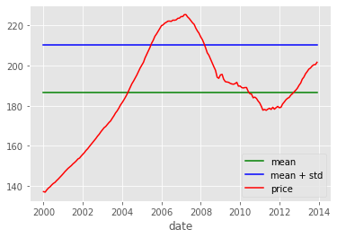
METHODOLOGY (PART-1): EXAMPLE
For this example, we have chosen the data of Housing Price Index of USA in the period 2000-2014. The price index has been seasonally adjusted. We calculate the mean which came out to be 186.5838 and standard deviation came out to be 23.907. The upper bound of mean+ standard deviation is thus equal to 210.4908. The plot is given below-

Slide 14
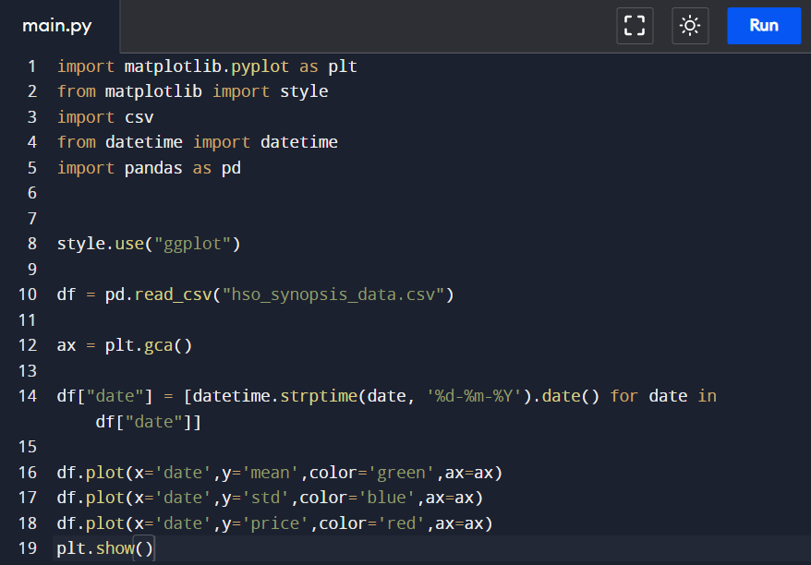
The code is:-

Slide 15
METHODOLOGY(PART-1): INTERPRETATION
As we can observe from the graph, as cost of living changes over the years, price index changes.
As it crosses the upper bound line in 2005 after that, we can see that it persistently increases, but still, we can’t say here with surety that bubble is forming up, as other factors may be contributing to price increase.
But conclusive evidence is seen around 2008, when price index falls sharply and even falls below mean line in 2010. This is burst of asset price bubble in housing sector where housing prices fall drastically after building up for a while and this is the famous 2008 US Housing Price Bubble burst we all know.
Hence, formation of asset price bubble is seen to start around 2005, which eventually bursts in 2008, continuing to affect the price of asset till 2010.

Slide 16
METHODOLOGY(PART-2)
The second part of our research framework would be to suggest the best response in order to tackle an asset price bubble and minimise the losses due to these bursts of asset price bubbles. This would be done through viewpoints of a monetary policy maker and a market participant.
Monetarists believe in the famous ‘Quantity Theory of Money. So, what approach which they should follow as far as controlling the money supply is concerned in order to make sure that these asset price bubbles do not have as devastating effect on the market as they usually have, would be discussed in detail in our research analysis.
Second major player in a market is the market participant himself. Asset price bubbles are formed most of the time due to irrational behaviour of market participants who keep investing in assets resulting in persistent increase in prices of assets. So, once an asset price bubble is identified, what should a market participant do in order to minimise his losses, would be discussed in detail in our research analysis

Slide 17
METHODOLOGY (PART-3, SECTION-1)
The first section of third part of our research work concerns analysis of factors which give rise to formation of asset price bubbles, which in turn, give rise to recession. In short, through this concept of asset price bubbles, we would be going to relate some economic variables to recession.
Two main economic variables, which we would be talking about in our research paper, would be-
1.Monetary Supply
2.Interest rates ( which would in turn tell us about scenario of credit in economy).
By doing the case study of the famous 1920 Stock Market bubble, which is commonly known as The Great Depression, we can say that monetary supply and interest rates have a positive or negative relation with formation of the price bubble, which in turn, would tell us about the relation of these variables with recession. For this purpose, we would be using the contemporary dataset of monetary supply and interest rates and would be analysing them dynamically and graphically in order to reach our conclusion.

Slide 18
METHODOLOGY ( PART -3, SECTION-2)
The second section of part three would involve analysis of the link between the occurrence of asset price bubbles and systemic risk contributions of individual financial institutions.
The prominent measure of systemic risk contribution is ∆CoVaR, given by Adrian and Brunnermeier (2016). It is used to quantify the contribution of a financial institution to the overall level of systemic risk by estimating additional value at risk, which is VaR of the entire financial system associated with the institution experiencing crisis.
VaR = Maximum return loss of institution i that would not be exceeded with probability q within certain time period:
CoVaR = VaR of system conditional on event C( Xi) of institution i
And
This is the difference between financial system’s value at risk conditional on institution i, realizing return losses at qth percentile and at 50th percentile.

Slide 19
METHODOLOGY (PART-3, SECTION-2)
.
This approach gives us the monthly estimates of ∆CoVaR of required no. of institutions. We can take its mean to have a better picture of the estimate.
Finally, in order to establish relationship between asset price bubble formation and systemic risk of individual financial institutions, we regress systemic risk of institution I at time t on:-
bank fixed effects
t bubble indicators for the booms and busts of stock market and real estate bubbles in country c at time t, the lagged bank-level variables size, loan growth, leverage, and maturity mismatch , the interaction terms with bubble indicators, and lagged country-specific macroeconomic control variables :
Here, the bank fixed effects would have control for important balance sheet characteristics, namely bank size, loan growth, leverage, and maturity mismatch and macroeconomic variables would be data of CPI or GDP deflator.

Slide 20
REFERENCES
Paul Atkinson, Asset Price Bubble Identification and Response, University of New Hampshire, published in Economic Commons, 2012. (BASE PAPER)
https://scholars.unh.edu/cgi/viewcontent.cgi?article=1001&context=honors#:~:text=This%20paper%20investigates%20the%20existence,both%20rational%20and%20irrational%20participants
Article by Investopedia, How Do Asset Price Bubbles Cause Recessions? (2020)
https://www.investopedia.com/articles/investing/082515/how-do-asset-bubbles-cause-recessions.asp
Brunnermeier, Rother and Schnabel, Asset Price Bubbles and Systemic Risk, published in Journal of Economic Perspectives, 2008.
https://scholar.princeton.edu/markus/publications/asset-price-bubbles-and-systemic-risk

Slide 21
TENTATIVE CONCLUSION TABLE
VARIABLE | PART OF RESEARCH PROBLEM | EXPECTED RELATION WITH PRICE BUBBLE
Real Price Index | The identification part,i.e. 1st part of research framework | Abnormal variations in real price index, i.e. sharp increase and sudden decrease, used in identification of bubbles.
Monetary Supply | The 3rd part of the research problem, which talks about factors contributing to bubble formation, hence recession. | A positive direct relation to probability of formation of asset price bubbles, i.e. increase in money supply, leads to increase in probability of price bubble formation.
Interest Rates | Section 1 of 3rd part of the research problem, which talks about factors contributing to bubble formation, hence recession. | A negative indirect relation to probability of formation of asset price bubbles, i.e. decrease in interest rate leads to easy credit in the economy, eventually leading to price bubble formation, hence recession.
∆CoVaR | Section 2 of 3rd part of the research problem, which talks about the relationship of asset price bubbles with systemic risk contributions of individual financial institutions. | Larger value of ∆CoVaR means higher systemic risk contribution and hence we expect positive sign for all the coefficients included in β, giving us a positive direct relationship between asset price bubble formation and systemic risk.

